Slide 1
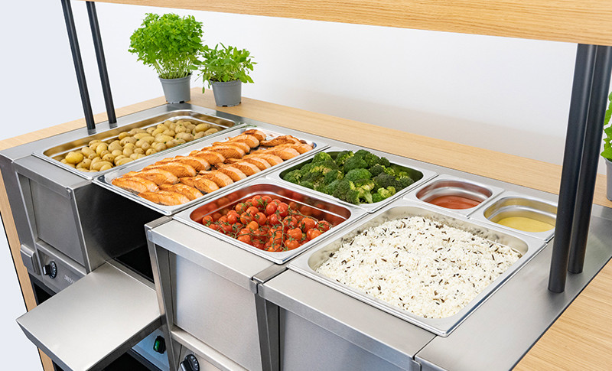
THERMA
DRY

Slide 2
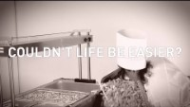
What is THERMA DRY?
Established since 1872

Slide 3
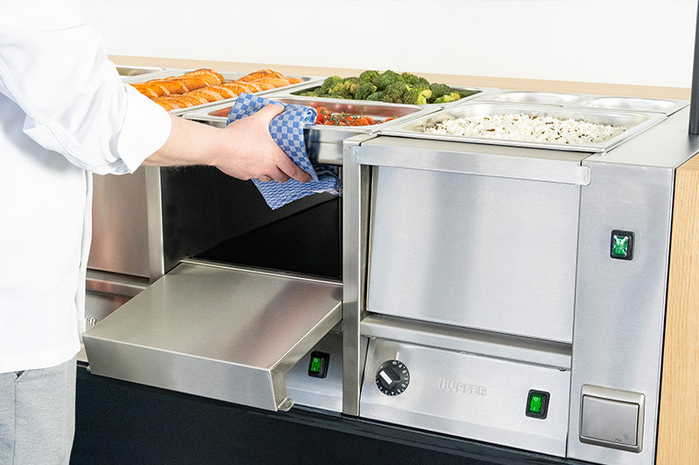
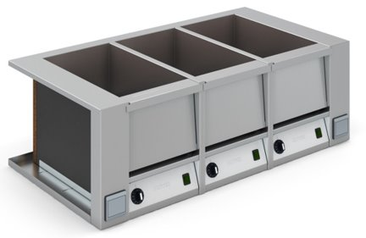
Established since 1872
THERMA DRY
Ideal handling
Ergonomic loading
No steam hazard
Easy to clean
The benefits are in the details

Slide 4
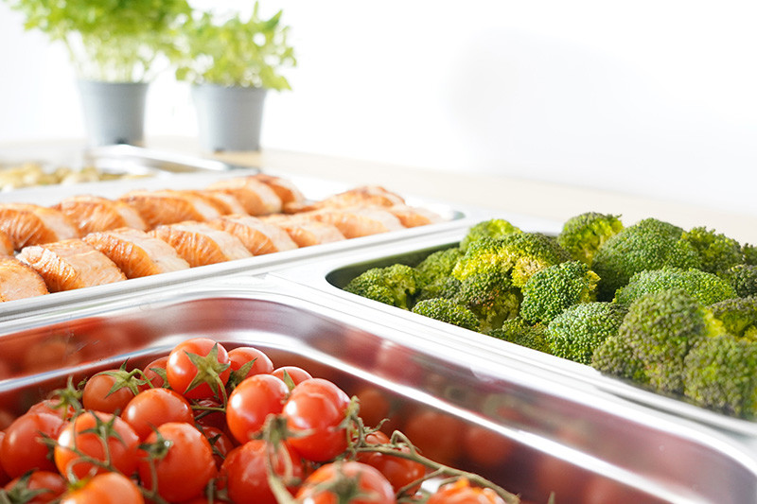
Established since 1872
THERMA DRY
Optimum food presentation
Constant temperature
Independent temperature regulator for each GN
No overcooking from reheating
The benefits are in the details

Slide 5
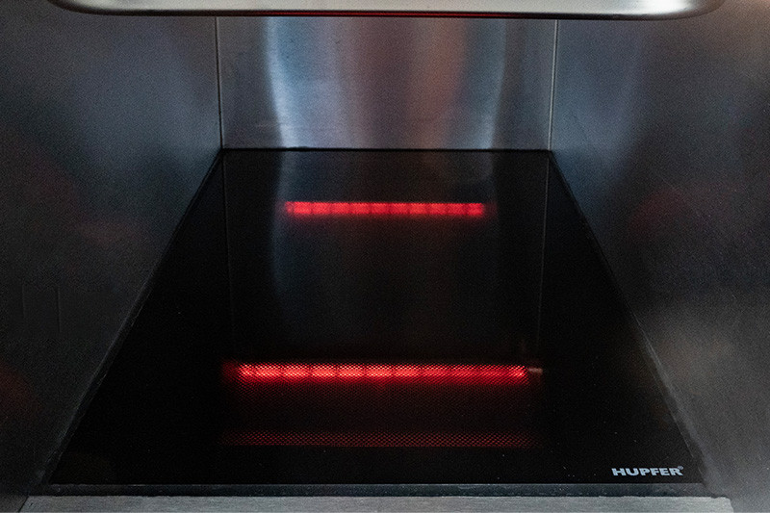
Established since 1872
THERMA DRY
Innovative technology
Patented infrared heat technology
No preheating required
Heat available immediately
The benefits are in the details

Slide 6
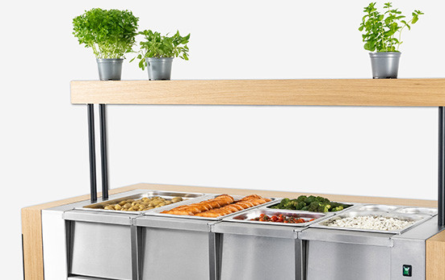
THERMA DRY
Cost and energy savings
63% less energy consumption
50% less CO2 emission
50% less connected load per GN (340 W vs 700 W)
The benefits are in the details

Slide 7
How you save money with THERMA DRY?
Established since 1872
Example Calculation
 | Therma Dry | Bain Marie Water
Installation Costs (one-time) | 0 € | 900 €
Operating Costs (per year) | 531.20 € | 1,121.30 €
Cleaning Costs (per year) | 143.10 € | 552.50 €
Total Savings in Year 1 1,899.50 € Total Savings after 5 years 5,897.50 €

Slide 8
Kalkulationsparameter Vergleichsprodukte Produkte Therma Dry Bain Marie Trocken Bain Marie Wasser Heiztechnologie Infrarot Rohrheizung 3 3 Anschlussleistung kW 0,34 0,70 0,90 Kalkulation im Gerät CO2 - Emissionen auf 10 Jahre t 5,3 11,2 11,2
How you save money with THERMA DRY?
Established since 1872
Example Calculation - Detail
Calculation parameters - comparison products
Products |  | Therma Dry | Bain Marie Dry | Bain Marie Water
Heating technology |  | Infrared | Tubular heating element | Tubular heating element
Number of pools | Pcs | 3 | 3 | 3
Connected load | kW | 0.34 | 0.70 | 0.90

Slide 9
Kalkulationsparameter Vergleichsprodukte Produkte Therma Dry Bain Marie Trocken Bain Marie Wasser Heiztechnologie Infrarot Rohrheizung 3 3 Anschlussleistung kW 0,34 0,70 0,90 Kalkulation im Gerät CO2 - Emissionen auf 10 Jahre t 5,3 11,2 11,2
How you save money with THERMA DRY?
Established since 1872
Example Calculation - Detail
Calculation parameters for the installation
Electrical |  | Sanitary
ø-cable length (m) | 15.00 | ø-pipe length (m) |  | 15.00
ø-Material costs ( €/linear meter) | 10.00 | ø-Material costs (€/linear meter) |  | 20.00
ø-labour costs (€/h) | 75.00 | ø-labour costs (€/h) |  | 75.00
ø-installation time (h) | 1.00 | ø-installation time (h) |  | 8.00

Slide 10
Kalkulationsparameter Vergleichsprodukte Produkte Therma Dry Bain Marie Trocken Bain Marie Wasser Heiztechnologie Infrarot Rohrheizung 3 3 Anschlussleistung kW 0,34 0,70 0,90 Kalkulation im Gerät CO2 - Emissionen auf 10 Jahre t 5,3 11,2 11,2
How you save money with THERMA DRY?
Established since 1872
Example Calculation - Detail
Installation costs per device (one-time)
 | Therma Dry | Bain Marie Dry |  | Bain Marie Water
Electrical material costs € | 150.00 | 150.00 |  | 150.00
Electrical labour costs € | 75.00 | 75.00 |  | 75.00
Material costs sanitary € | 0.00 | 0.00 |  | 300.00
Sanitary labour costs € | 0.00 | 0.00 |  | 600.00
Total Installation costs € | 225.00 | 225.00 |  | 1125.00

Slide 11
Kalkulationsparameter Vergleichsprodukte Produkte Therma Dry Bain Marie Trocken Bain Marie Wasser Heiztechnologie Infrarot Rohrheizung 3 3 Anschlussleistung kW 0,34 0,70 0,90 Kalkulation im Gerät CO2 - Emissionen auf 10 Jahre t 5,3 11,2 11,2
How you save money with THERMA DRY?
Established since 1872
Example Calculation - Detail
Calculation parameters for operating costs per device
Uses per day | 1.00 | ø-water requirement per basin l |  | 3.00
Operating times per use (h) | 5.00 | ø-Drainage costs | €/m³ | 10.00
Working days per week (day) | 5.00 | ø-Labour costs* cleaning | €/h | 25.00
Working weeks per year (week) | 52.00 | *Full cost rate incl. cleaning agents
ø-energy costs €/kWh | 0.42

Slide 12
Kalkulationsparameter Vergleichsprodukte Produkte Therma Dry Bain Marie Trocken Bain Marie Wasser Heiztechnologie Infrarot Rohrheizung 3 3 Anschlussleistung kW 0,34 0,70 0,90 Kalkulation im Gerät CO2 - Emissionen auf 10 Jahre t 5,3 11,2 11,2
How you save money with THERMA DRY?
Established since 1872
Example Calculation - Detail
 |  | Therma Dry | Bain Marie Dry | Bain Marie Dry | Bain Marie Water
Energy costs per device
Energy consumption* per year kWh |  | 1259.7 |  | 2659.0 | 2659.0
Energy costs per year € |  | 531.2 |  | 1121.3 | 1121.3
*The energy consumption is made up of the product-specific heating time and the heat retention phase.
Water consumption per device
Water consumption per year | l | 0.0 |  | 0.0 | 2340.0
Wastewater costs per year | € | 0.0 |  | 0.0 | 23.4
Cleaning costs per device
Cleaning time per year | h | 5.72 |  | 5.72 | 22.10
Cleaning costs per year | € | 143.00 |  | 143.00 | 552.50

Slide 13
Kalkulationsparameter Vergleichsprodukte Produkte Therma Dry Bain Marie Trocken Bain Marie Wasser Heiztechnologie Infrarot Rohrheizung 3 3 Anschlussleistung kW 0,34 0,70 0,90 Kalkulation im Gerät CO2 - Emissionen auf 10 Jahre t 5,3 11,2 11,2
How you save money with THERMA DRY?
Established since 1872
Sustainability: CO2 Emissions per device
 | Therma Dry | Bain Marie Dry | Bain Marie Water
Calculation parameters for Co2 emissions: Co2 emission: 420 g/kWh Product lifecycle: 10 years
CO2 emissions during 10 years (product lifecycle) | 5.3 t | 11.2 t | 11.2 t

Slide 14
THERMA DRY – Technical Information
Established since 1872
Installation:
Built-in over a base support with expansion joint of 3 mm sealed with specified silicone
Single phase connection and low connected load (340 W)
No water / drainage installation required
Detailed installation instructions with electrical schema and operating manual provided
Provided documents:
- Spare parts list
- Maintenance instructions
- Assembly instructions
- Operating manual
- Specifications sheet and tender specification
If necessary, these documents can be translated to Polish language

Slide 15











Established since 1872
REFERENCES
HUPFER
DROP INS
(Therma Dry and
Hot-Cold Plate)

Slide 16
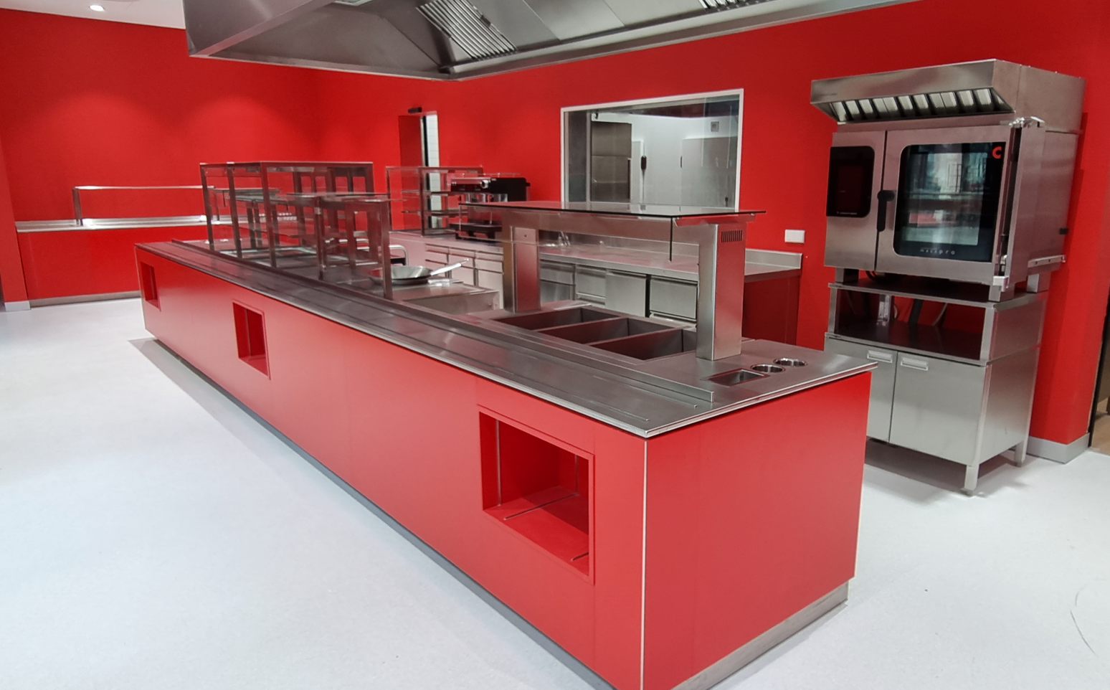
Established since 1872

Slide 17
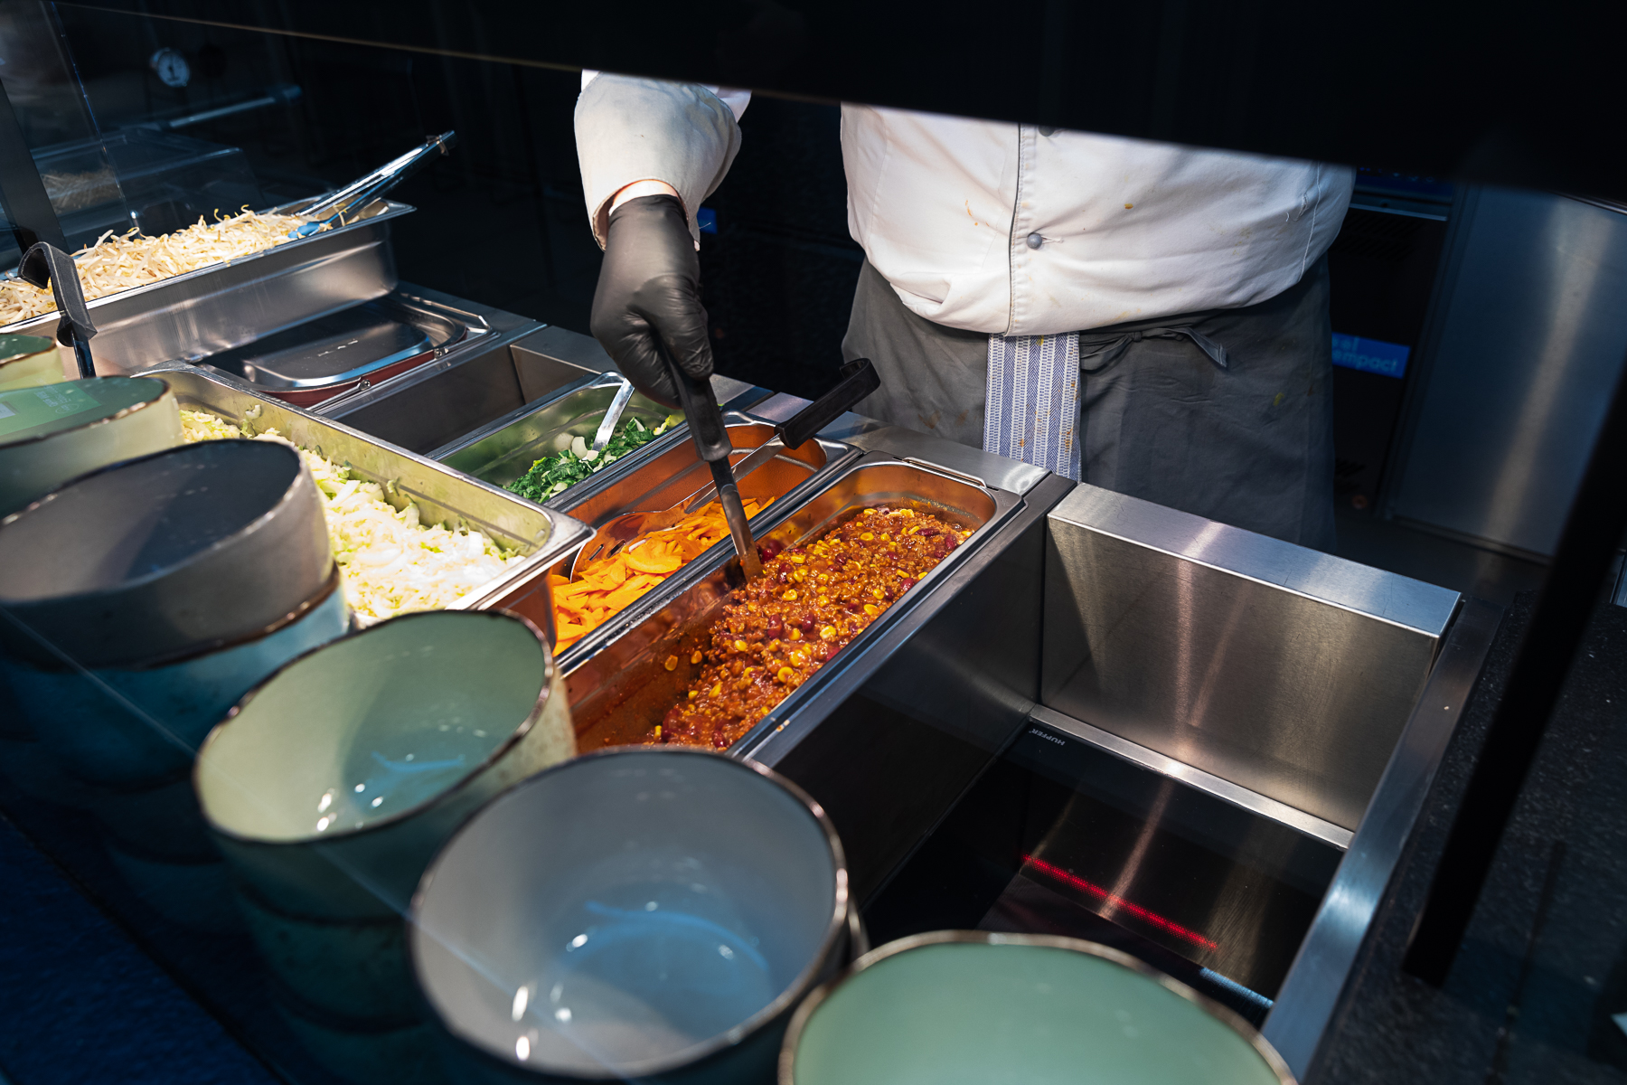
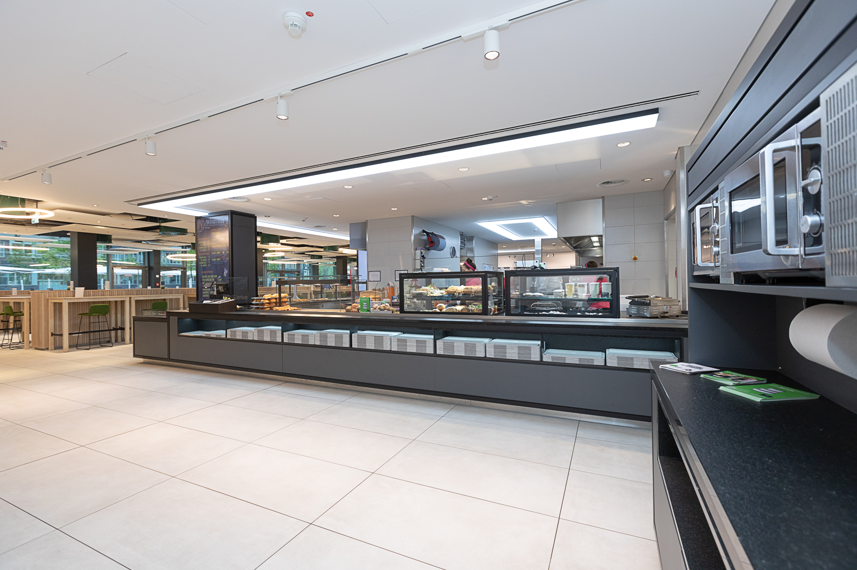
Established since 1872
Notes:
RWE Contangos 2 / 1 of 2 company restaurants at RWE Essen.
1st Restaurant called „Casino“ and it is for 1000 guests per day.
2nd Restaurant called „Contangos 2“ and is for 500 guests per day.
Opened in 2022
Hupfer Products:
Therma Dry
Hot & Cold Plate

Slide 18
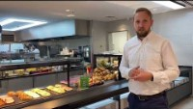
Established since 1872
Notes:
RWE Contangos 2 / 1 of 2 company restaurants at RWE Essen.
1st Restaurant called „Casino“ and it is for 1000 guests per day.
2nd Restaurant called „Contangos 2“ and is for 500 guests per day.
Opened in 2022
Hupfer Products:
Therma Dry
Hot & Cold Plate

Slide 19


THANK YOU!

